Slide 1

15CSE301 Computer Organization and Architecture
Memory
Reference:
Chapter 7
Computer Organization and Design, The hardware / software interface, 3rd Edition
Chapter 5 in 4th Edition
Dr Ganesh Neelakanta Iyer
Associate Professor, Dept of Computer Science and Engg
Amrita Vishwa Vidyapeetham, Coimbatore

Slide 2
Chapter 5
Large and Fast: Exploiting Memory Hierarchy

Slide 3
Memory Technology
Static RAM (SRAM)
0.5ns – 2.5ns, $2000 – $5000 per GB
Dynamic RAM (DRAM)
50ns – 70ns, $20 – $75 per GB
Magnetic disk
5ms – 20ms, $0.20 – $2 per GB
Ideal memory
Access time of SRAM
Capacity and cost/GB of disk

Slide 4
Principle of Locality
Programs access a small proportion of their address space at any time
Temporal locality (in time)
Items accessed recently are likely to be accessed again soon
e.g., instructions in a loop, induction variables
Spatial locality (in space)
Items near those accessed recently are likely to be accessed soon
E.g., sequential instruction access, array data

Slide 5
Taking Advantage of Locality
Memory hierarchy
Store everything on disk
Copy recently accessed (and nearby) items from disk to smaller DRAM memory
Main memory
Copy more recently accessed (and nearby) items from DRAM to smaller SRAM memory
Cache memory attached to CPU

Slide 6
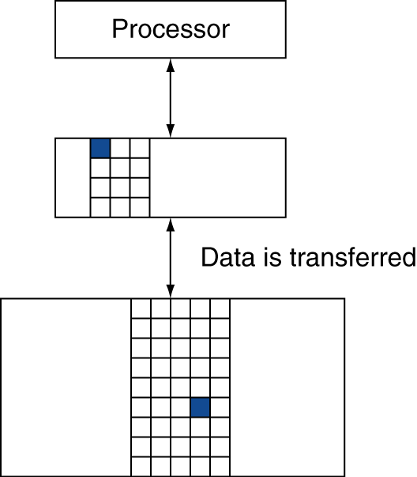
Memory Hierarchy Levels
Block (aka line): unit of copying
May be multiple words
If accessed data is present in upper level
Hit: access satisfied by upper level
Hit ratio: hits/accesses
If accessed data is absent
Miss: block copied from lower level
Time taken: miss penalty
Miss ratio: misses/accesses = 1 – hit ratio
Then accessed data supplied from upper level

Slide 7
The Memory Hierarchy: Terminology
Hit Rate: the fraction of memory accesses found in a level of the memory hierarchy
Hit Time: Time to access that level which consists of
Time to access the block + Time to determine hit/miss
Miss Rate: the fraction of memory accesses not found in a level of the memory hierarchy ⇒ 1 - (Hit Rate)
Miss Penalty: Time to replace a block in that level with the corresponding block from a lower level which consists of
Time to access the block in the lower level + Time to transmit that block to the level that experienced the miss + Time to insert the block in that level + Time to pass the block to the requestor
Hit Time << Miss Penalty
Notes:
A HIT is when the data the processor wants to access is found in the upper level (Blk X).
The fraction of the memory access that are HIT is defined as HIT rate.
HIT Time is the time to access the Upper Level where the data is found (X). It consists of:
(a) Time to access this level.
(b) AND the time to determine if this is a Hit or Miss.
If the data the processor wants cannot be found in the Upper level. Then we have a miss and we need to retrieve the data (Blk Y) from the lower level.
By definition (definition of Hit: Fraction), the miss rate is just 1 minus the hit rate.
This miss penalty also consists of two parts:
(a) The time it takes to replace a block (Blk Y to BlkX) in the upper level.
(b) And then the time it takes to deliver this new block to the processor.
It is very important that your Hit Time to be much much smaller than your miss penalty. Otherwise, there will be no reason to build a memory hierarchy.

Slide 8
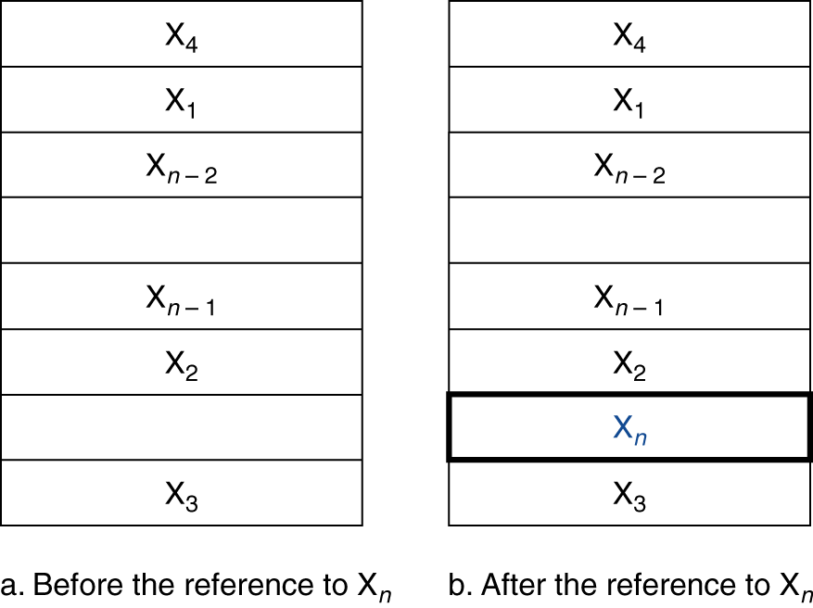
Cache Memory
Cache memory
The level of the memory hierarchy closest to the CPU
Given accesses X₁, …, X_{n–1}, X_{n}
How do we know if the data is present?
Where do we look?

Slide 9
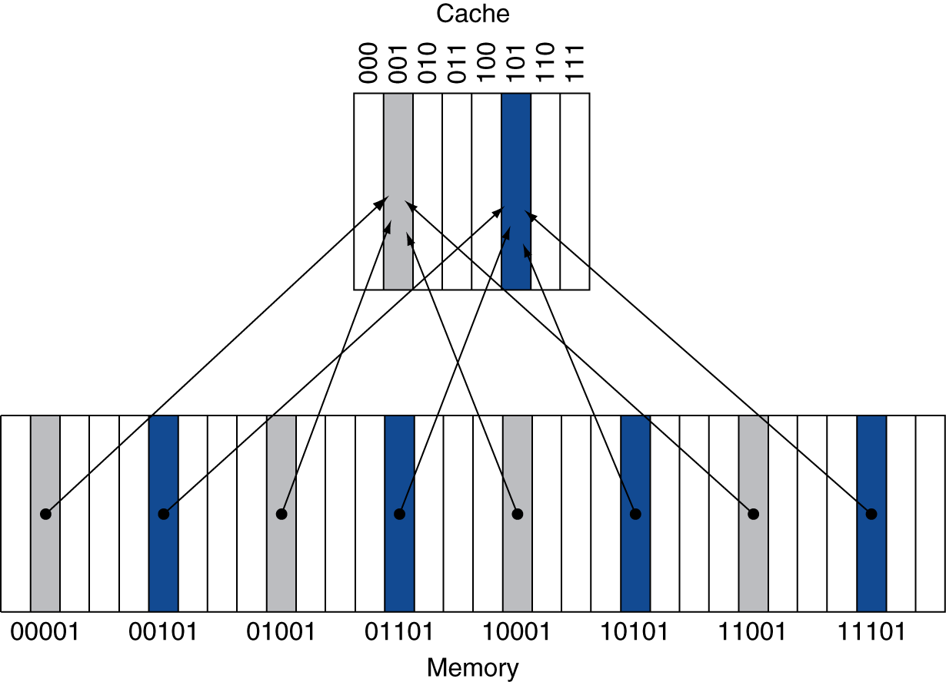
Direct Mapped Cache
Location determined by address
Direct mapped: only one choice
(Block address) modulo (#Blocks in cache)
#Blocks is a power of 2
Use low-order address bits

Slide 10
Tags and Valid Bits
How do we know which particular block is stored in a cache location?
Store block address as well as the data
Actually, only need the high-order bits
Called the tag
What if there is no data in a location?
Valid bit: 1 = present, 0 = not present
Initially 0

Slide 11
Cache Example
8-blocks, 1 word/block, direct mapped
Initial state
Index | V | Tag | Data
000 | N
001 | N
010 | N
011 | N
100 | N
101 | N
110 | N
111 | N

Slide 12
Cache Example
Word addr | Binary addr | Hit/miss | Cache block
22 | 10 110 | Miss | 110
Index | V | Tag | Data
000 | N
001 | N
010 | N
011 | N
100 | N
101 | N
110 | Y | 10 | Mem[10110]
111 | N

Slide 13
Cache Example
Word addr | Binary addr | Hit/miss | Cache block
26 | 11 010 | Miss | 010
Index | V | Tag | Data
000 | N
001 | N
010 | Y | 11 | Mem[11010]
011 | N
100 | N
101 | N
110 | Y | 10 | Mem[10110]
111 | N

Slide 14
Cache Example
Word addr | Binary addr | Hit/miss | Cache block
22 | 10 110 | Hit | 110
26 | 11 010 | Hit | 010
Index | V | Tag | Data
000 | N
001 | N
010 | Y | 11 | Mem[11010]
011 | N
100 | N
101 | N
110 | Y | 10 | Mem[10110]
111 | N

Slide 15
Cache Example
Word addr | Binary addr | Hit/miss | Cache block
16 | 10 000 | Miss | 000
3 | 00 011 | Miss | 011
16 | 10 000 | Hit | 000
Index | V | Tag | Data
000 | Y | 10 | Mem[10000]
001 | N
010 | Y | 11 | Mem[11010]
011 | Y | 00 | Mem[00011]
100 | N
101 | N
110 | Y | 10 | Mem[10110]
111 | N

Slide 16
Cache Example
Word addr | Binary addr | Hit/miss | Cache block
18 | 10 010 | Miss | 010
Index | V | Tag | Data
000 | Y | 10 | Mem[10000]
001 | N
010 | Y | 10 | Mem[10010]
011 | Y | 00 | Mem[00011]
100 | N
101 | N
110 | Y | 10 | Mem[10110]
111 | N

Slide 17
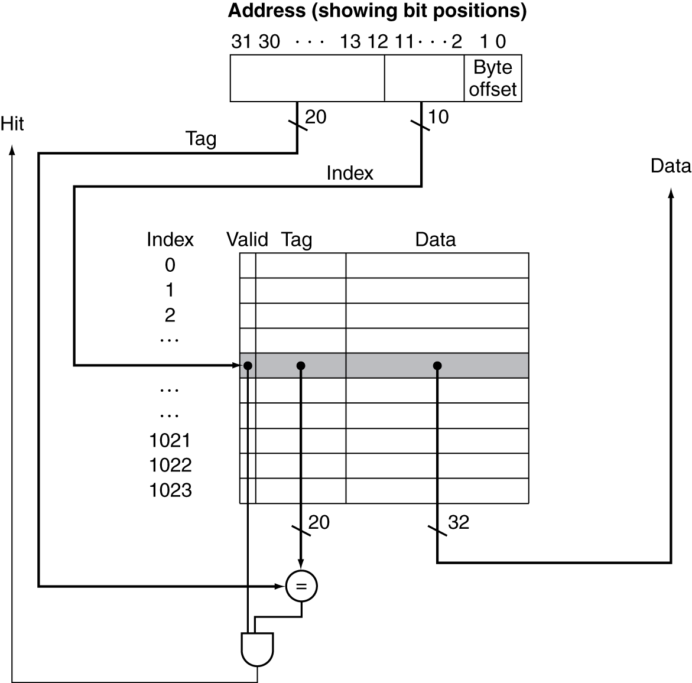
Address Subdivision

Slide 18
Caching: A Simple First Example
Main Memory
0000xx
0001xx
0010xx
0011xx
0100xx
0101xx
0110xx
0111xx
1000xx
1001xx
1010xx
1011xx
1100xx
1101xx
1110xx
1111xx
Cache
One word blocks
Two low order bits define the byte in the word (32b words)
Index
Valid
Tag
Data
00
01
10
11
Q2: How do we find it?
Use next 2 low order memory address bits – the index – to determine which cache block (i.e., modulo the number of blocks in the cache)
Q1: Is it there?
Compare the cache tag to the high order 2 memory address bits to tell if the memory block is in the cache
(block address) modulo (# of blocks in the cache)
Notes:
For class handout

Slide 19
Caching: A Simple First Example
Main Memory
0000xx
0001xx
0010xx
0011xx
0100xx
0101xx
0110xx
0111xx
1000xx
1001xx
1010xx
1011xx
1100xx
1101xx
1110xx
1111xx
Cache
One word blocks
Two low order bits define the byte in the word (32b words)
Index
Valid
Tag
Data
00
01
10
11
Q2: How do we find it?
Use next 2 low order memory address bits – the index – to determine which cache block (i.e., modulo the number of blocks in the cache)
Q1: Is it there?
Compare the cache tag to the high order 2 memory address bits to tell if the memory block is in the cache
(block address) modulo (# of blocks in the cache)
Notes:
For lecture
Valid bit indicates whether an entry contains valid information – if the bit is not set, there cannot be a match for this block

Slide 20
Direct Mapped Cache
Consider the main memory word reference string
0 1 2 3 4 3 4 15
Start with an empty cache - all blocks initially marked as not valid
0
1
2
3
4
3
4
15
Notes:
For class handout

Slide 21
Direct Mapped Cache
Consider the main memory word reference string
0 1 2 3 4 3 4 15
Start with an empty cache - all blocks initially marked as not valid
0
miss
1
miss
2
miss
3
miss
00 Mem(0)
00 Mem(0)
00 Mem(0)
00 Mem(1)
00 Mem(0)
00 Mem(1)
00 Mem(2)
00 Mem(1)
00 Mem(2)
00 Mem(3)
4
miss
3
hit
4
hit
15
miss
01
4
00 Mem(0)
00 Mem(1)
00 Mem(2)
00 Mem(3)
01 Mem(4)
00 Mem(1)
00 Mem(2)
00 Mem(3)
01 Mem(4)
00 Mem(1)
00 Mem(2)
00 Mem(3)
01 Mem(4)
00 Mem(1)
00 Mem(2)
00 Mem(3)
11
15
8 requests, 6 misses
Notes:
For lecture
Reference string is word addresses (or block number since we are using one word blocks) – i.e., the low order two bits used to selected the byte in the 32-bit word are ignored

Slide 22
MIPS Direct Mapped Cache Example
One word blocks, cache size = 1K words (or 4KB)
Byte offset
31 30 . . . 13 12 11 . . . 2 1 0
Hit
Tag
20
10
Data
Index
Index
Valid
Tag
Data
0
1
2
.
.
.
1021
1022
1023
20
32
What kind of locality are we taking advantage of?
Notes:
Let’s use a specific example with realistic numbers: assume we have a 1 K word (4Kbyte) direct mapped cache with block size equals to 4 bytes (1 word).
In other words, each block associated with the cache tag will have 4 bytes in it (Row 1).
With Block Size equals to 4 bytes, the 2 least significant bits of the address will be used as byte select within the cache block.
Since the cache size is 1K word, the upper 32 minus 10+2 bits, or 20 bits of the address will be stored as cache tag.
The rest of the (10) address bits in the middle, that is bit 2 through 11, will be used as Cache Index to select the proper cache entry
Temporal!

Slide 23
Multiword Block Direct Mapped Cache
Four words/block, cache size = 1K words
Byte offset
Hit
31 30 . . . 13 12 11 . . . 4 3 2 1 0
Data
Tag
20
8
Block offset
Index
Index
Valid
Tag
Data
0
1
2
.
.
.
253
254
255
20
32
What kind of locality are we taking advantage of?
Notes:
to take advantage for spatial locality want a cache block that is larger than word word in size.

Slide 24
Taking Advantage of Spatial Locality
Let cache block hold more than one word
0 1 2 3 4 3 4 15
Start with an empty cache - all blocks initially marked as not valid
0
1
2
3
4
3
4
15
Notes:
For class handout

Slide 25
Taking Advantage of Spatial Locality
Let cache block hold more than one word
0 1 2 3 4 3 4 15
Start with an empty cache - all blocks initially marked as not valid
0
miss
1
hit
2
miss
00 Mem(1) Mem(0)
00 Mem(1) Mem(0)
00 Mem(1) Mem(0)
00 Mem(3) Mem(2)
3
hit
4
miss
3
hit
01
5
4
00 Mem(1) Mem(0)
00 Mem(1) Mem(0)
01 Mem(5) Mem(4)
00 Mem(3) Mem(2)
00 Mem(3) Mem(2)
00 Mem(3) Mem(2)
4
hit
15
miss
01 Mem(5) Mem(4)
11
01 Mem(5) Mem(4)
15
14
00 Mem(3) Mem(2)
00 Mem(3) Mem(2)
8 requests, 4 misses
Notes:
For lecture
Show the 4-bit address mapping – 2-bits of tag, 1-bit of set address (index), 1-bit of word-in-block select

Slide 26
Total # of bit needed for a cache
function of the cache size and the address size.
For the following
32-bit byte addresses
A direct-mapped cache
The cache size is 2^{n} blocks
n bits for the index
The block size is 2^{m} words (2^{m+2} bytes)
m bits for the word within the block
tag size = 32 – (n+m+2).
Total # of bits = 2^{n} *(block size+tag size+valid field size)

Slide 27
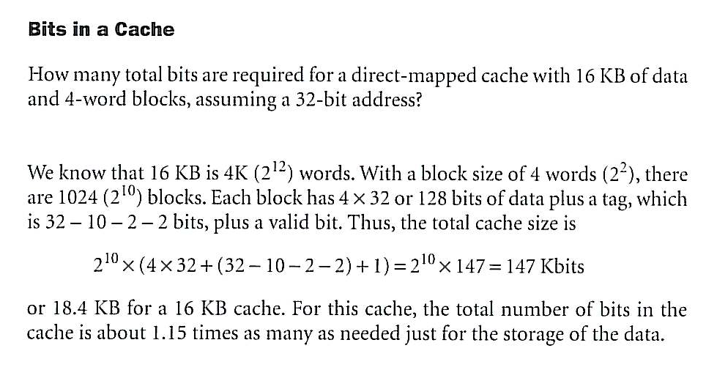
Example

Slide 28
Example: Larger Block Size
64 blocks, 16 bytes/block
To what block number does address 1200 map?
Block address = ⎣1200/16⎦ = 75
Block number = 75 modulo 64 = 11
31
10
9
4
3
0
Tag
Index
Offset
22 bits
6 bits
4 bits

Slide 29
Sources of Cache Misses
Compulsory (cold start or process migration, first reference):
First access to a block, “cold” fact of life, not a whole lot you can do about it. If you are going to run “millions” of instruction, compulsory misses are insignificant
Solution: increase block size (increases miss penalty; very large blocks could increase miss rate)
Capacity:
Cache cannot contain all blocks accessed by the program
Solution: increase cache size (may increase access time)
Conflict (collision):
Multiple memory locations mapped to the same cache location
Solution 1: increase cache size
Solution 2: increase associativity (stay tuned) (may increase access time)
Notes:
(Capacity miss) That is the cache misses are due to the fact that the cache is simply not large enough to contain all the blocks that are accessed by the program.
The solution to reduce the Capacity miss rate is simple: increase the cache size.
Here is a summary of other types of cache miss we talked about.
First is the Compulsory misses. These are the misses that we cannot avoid. They are caused when we first start the program.
Then we talked about the conflict misses. They are the misses that caused by multiple memory locations being mapped to the same cache location.
There are two solutions to reduce conflict misses. The first one is, once again, increase the cache size. The second one is to increase the associativity.
For example, say using a 2-way set associative cache instead of directed mapped cache.
But keep in mind that cache miss rate is only one part of the equation. You also have to worry about cache access time and miss penalty. Do NOT optimize miss rate alone.
Finally, there is another source of cache miss we will not cover today. Those are referred to as invalidation misses caused by another process, such as IO , update the main memory so you have to flush the cache to avoid inconsistency between memory and cache.
+2 = 43 min. (Y:23)

Slide 30
Block Size Considerations
Larger blocks should reduce miss rate
Due to spatial locality
But in a fixed-sized cache
Larger blocks ⇒ fewer of them
More competition ⇒ increased miss rate
Larger miss penalty
Can override benefit of reduced miss rate
Early restart
Resume exe. as soon as the requested word of the block is returned
critical-word-first

Slide 31
Cache Misses
On cache hit, CPU proceeds normally
On cache miss
Stall the CPU pipeline
Fetch block from next level of hierarchy
Instruction cache miss
Restart instruction fetch
Data cache miss
Complete data access

Slide 32
Write-Through
On data-write hit, could just update the block in cache
But then cache and memory would be inconsistent
Write through: All writes go to main memory as well as cache
Lots of traffic
Slows down writes
But makes writes take longer
e.g., if base CPI = 1 without misses, 10% of instructions are stores, write to memory takes 100 cycles
Effective CPI = 1 + 0.1×100 = 11

Slide 33
Write-Through
Solution: write buffer
Holds data waiting to be written to memory
CPU continues immediately
Only stalls on write if write buffer is already full

Slide 34
Write-Back
Alternative: On data-write hit (block is already in cache but needs to be updated) just update the block in cache
Keep track of whether each block is dirty
When a dirty block is replaced
Write it back to memory
Can use a write buffer to allow replacing block to be read first

Slide 35
Write Allocation
What should happen on a write miss?
Alternatives for write-through
Allocate on miss: fetch the block
Write around: don’t fetch the block
Since programs often write a whole block before reading it (e.g., initialization)
For write-back
Usually fetch the block

Slide 36
Main Memory Supporting Caches
Use DRAMs for main memory
Fixed width (e.g., 1 word)
Connected by fixed-width clocked bus
Bus clock is typically slower than CPU clock
Example cache block read
1 bus cycle for address transfer
15 bus cycles per DRAM access
1 bus cycle per data transfer
For 4-word block, 1-word-wide DRAM
Miss penalty = 1 + 4×15 + 4×1 = 65 bus cycles
The number of bytes transferred per bus cycle for a single miss is
Bandwidth = 16 bytes / 65 cycles = 0.25 B/cycle

Slide 37
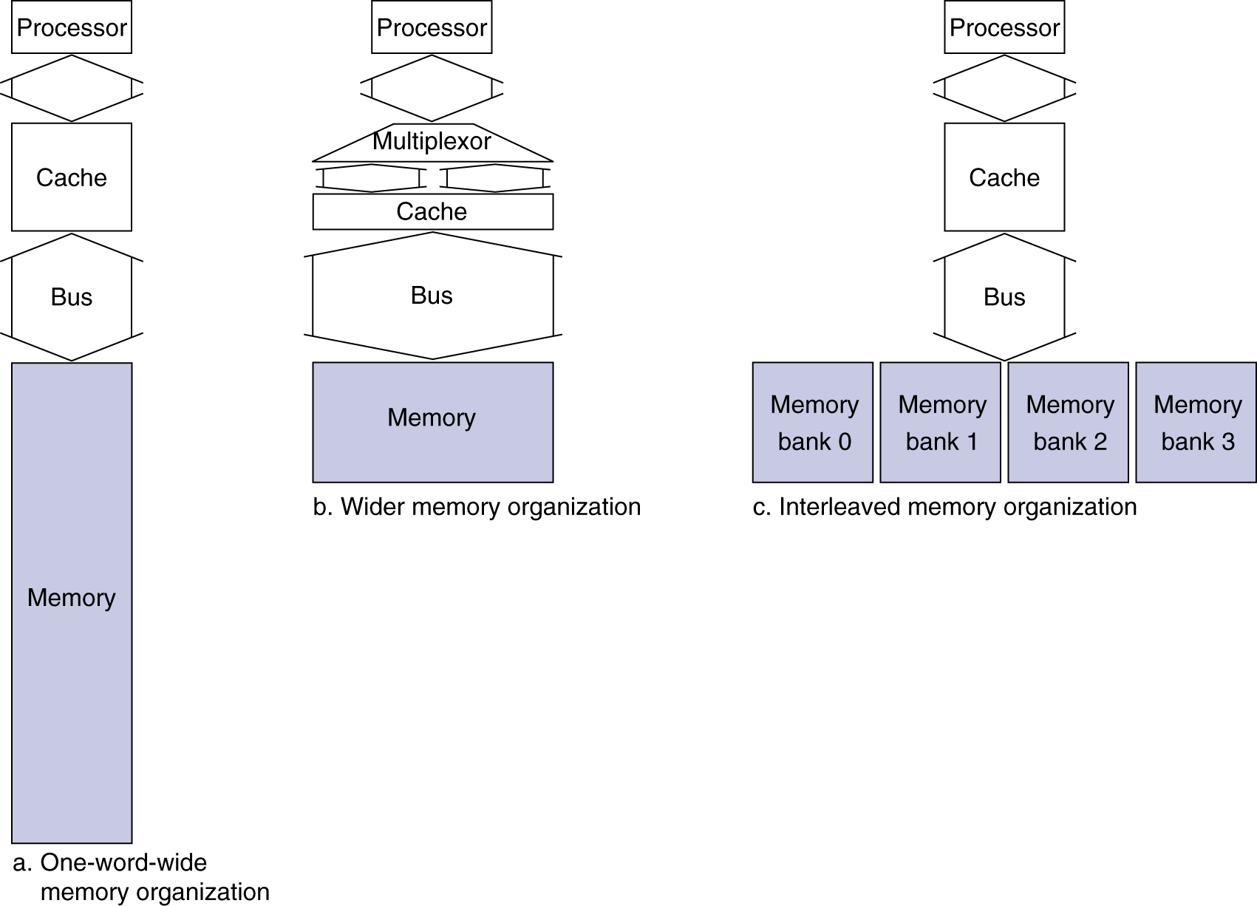
Increasing Memory Bandwidth
4-word wide memory
Miss penalty = 1 + 15 + 1 = 17 bus cycles
Bandwidth = 16 bytes / 17 cycles = 0.94 B/cycle
4-bank interleaved memory
Miss penalty = 1 + 15 + 4×1 = 20 bus cycles
Bandwidth = 16 bytes / 20 cycles = 0.8 B/cycle

Slide 38
Advanced DRAM Organization
Bits in a DRAM are organized as a rectangular array
DRAM accesses an entire row
Burst mode: supply successive words from a row with reduced latency
Double data rate (DDR) DRAM
Transfer on rising and falling clock edges
Quad data rate (QDR) DRAM
Separate DDR inputs and outputs

Slide 39
Measuring Cache Performance
Components of CPU time
Program execution cycles
Includes cache hit time
Memory stall cycles
Mainly from cache misses
With simplifying assumptions:

Slide 40
Cache Performance Example
Given
I-cache miss rate = 2%
D-cache miss rate = 4%
Miss penalty = 100 cycles
Base CPI (ideal cache) = 2
Load & stores are 36% of instructions
Miss cycles per instruction
I-cache: 0.02 × 100 = 2
D-cache: 0.36 × 0.04 × 100 = 1.44
Actual CPI = 2 + 2 + 1.44 = 5.44
Ideal CPU is 5.44/2 =2.72 times faster

Slide 41
Average Access Time
Hit time is also important for performance
Average memory access time (AMAT)
AMAT = Hit time + Miss rate × Miss penalty
Example
CPU with 1ns clock, hit time = 1 cycle, miss penalty = 20 cycles, I-cache miss rate = 5%
AMAT = 1 + 0.05 × 20 = 2ns
2 cycles per instruction

Slide 42
Performance Summary
When CPU performance increased
Miss penalty becomes more significant
Decreasing base CPI
Greater proportion of time spent on memory stalls
Increasing clock rate
Memory stalls account for more CPU cycles
Can’t neglect cache behavior when evaluating system performance

Slide 43
Associative Caches
Fully associative
Allow a given block to go in any cache entry
Requires all entries to be searched at once
Comparator per entry (expensive)
n-way set associative
Each set contains n entries
Block number determines which set
(Block number) modulo (#Sets in cache)
Search all entries in a given set at once
n comparators (less expensive)

Slide 44
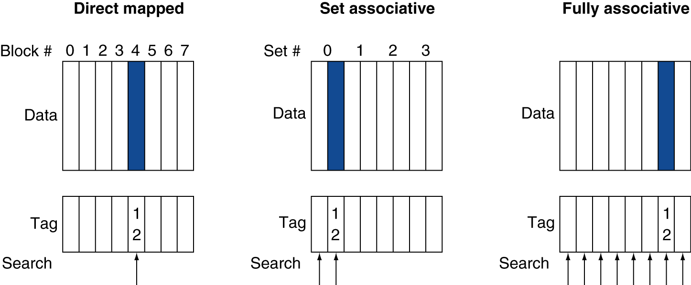
Associative Cache Example

Slide 45
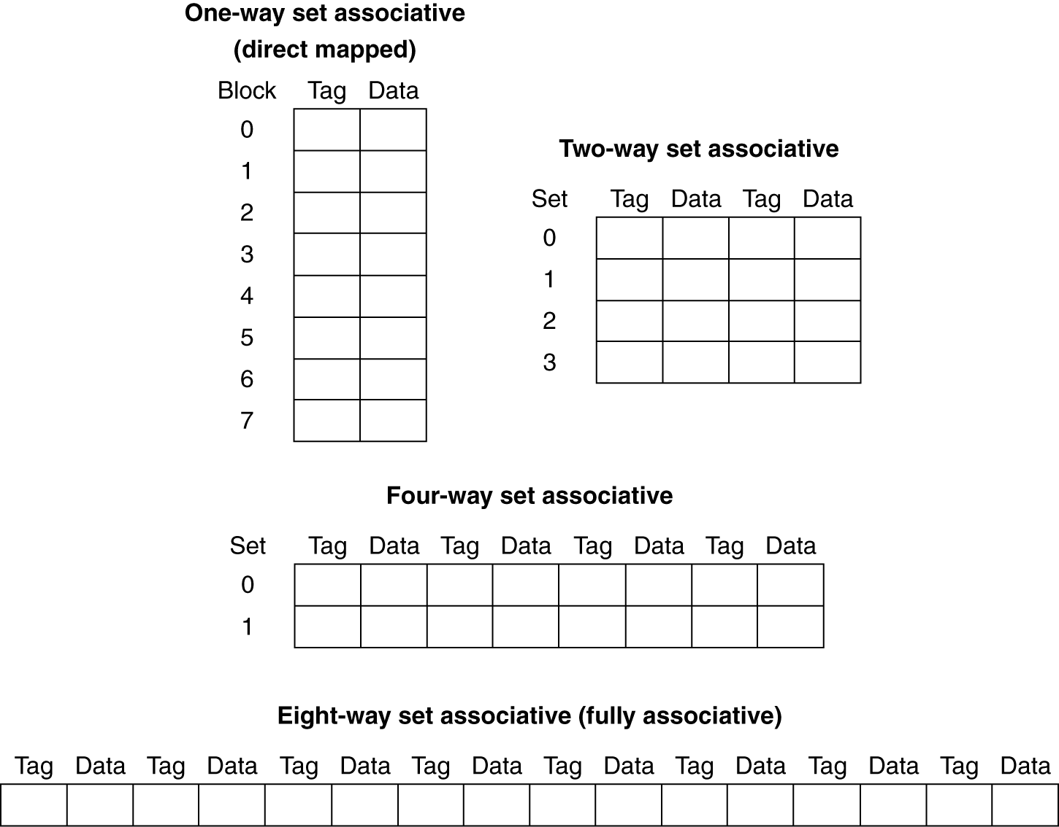
Spectrum of Associativity
For a cache with 8 entries

Slide 46
Associativity Example
Compare 4-block caches
Direct mapped, 2-way set associative, fully associative
Block access sequence: 0, 8, 0, 6, 8
Direct mapped
Block address | Cache index | Hit/miss | Cache content after access
 |  |  | 0 | 1 | 2 | 3
0 | 0 | miss | Mem[0]
8 | 0 | miss | Mem[8]
0 | 0 | miss | Mem[0]
6 | 2 | miss | Mem[0] |  | Mem[6]
8 | 0 | miss | Mem[8] |  | Mem[6]

Slide 47
Associativity Example
2-way set associative
Block address | Cache index | Hit/miss | Cache content after access
 |  |  | Set 0 |  | Set 1
0 | 0 | miss | Mem[0]
8 | 0 | miss | Mem[0] | Mem[8]
0 | 0 | hit | Mem[0] | Mem[8]
6 | 0 | miss | Mem[0] | Mem[6]
8 | 0 | miss | Mem[8] | Mem[6]
Fully associative
Block address |  | Hit/miss | Cache content after access
0 |  | miss | Mem[0]
8 |  | miss | Mem[0] | Mem[8]
0 |  | hit | Mem[0] | Mem[8]
6 |  | miss | Mem[0] | Mem[8] | Mem[6]
8 |  | hit | Mem[0] | Mem[8] | Mem[6]

Slide 48
How Much Associativity
Increased associativity decreases miss rate
But with diminishing returns
Simulation of a system with 64KB D-cache, 16-word blocks, SPEC2000
1-way: 10.3%
2-way: 8.6%
4-way: 8.3%
8-way: 8.1%

Slide 49
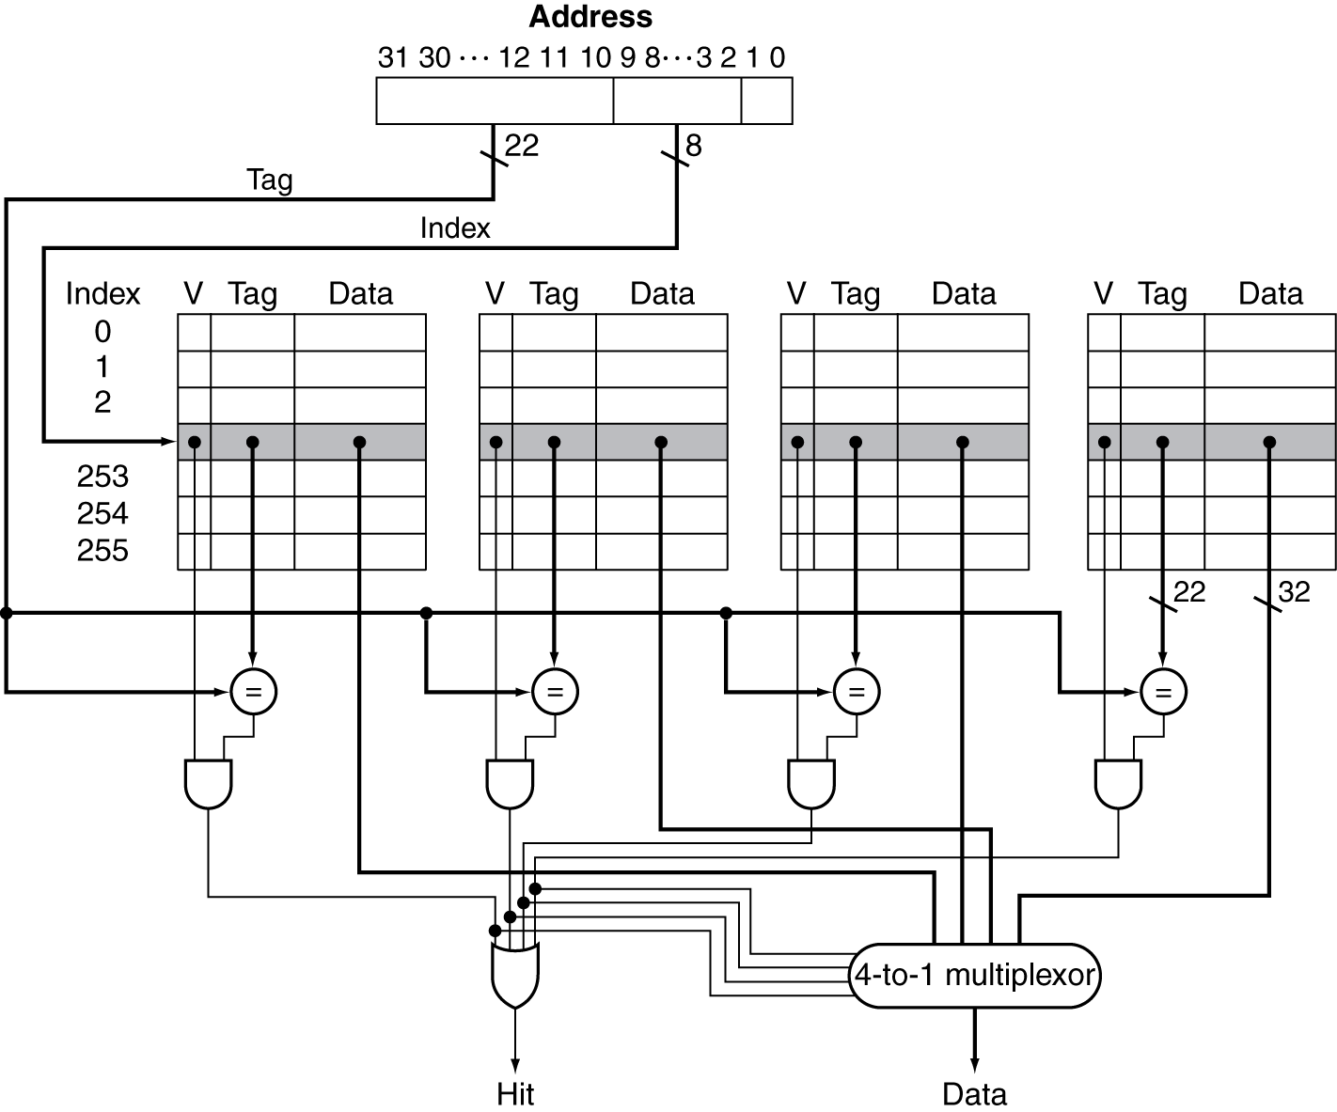
Set Associative Cache Organization

Slide 50
Replacement Policy
Direct mapped: no choice
Set associative
Prefer non-valid entry, if there is one
Otherwise, choose among entries in the set
Least-recently used (LRU)
Choose the one unused for the longest time
Simple for 2-way, manageable for 4-way, too hard beyond that
Random
Gives approximately the same performance as LRU for high associativity

Slide 51
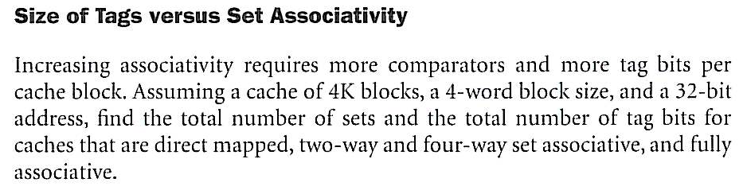
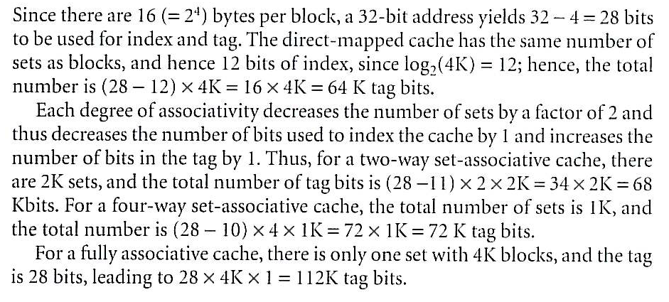
Example

Slide 52
Multilevel Caches
Primary cache attached to CPU
Small, but fast
Level-2 cache services misses from primary cache
Larger, slower, but still faster than main memory
Main memory services L-2 cache misses
Some high-end systems include L-3 cache

Slide 53
Multilevel Cache Example
Given
CPU base CPI = 1, clock rate = 4GHz
Miss rate/instruction = 2%
Main memory access time = 100ns
With just primary cache
Miss penalty = 100ns/0.25ns = 400 cycles
Effective CPI = 1 + 0.02 × 400 = 9

Slide 54
Example (cont.)
Now add L-2 cache
Access time = 5ns
Global miss rate to main memory = 0.5%
Primary miss with L-2 hit
Penalty = 5ns/0.25ns = 20 cycles
Primary miss with L-2 miss
Extra penalty = 500 cycles
CPI = 1 + 0.02 × 20 + 0.005 × 400 = 3.4
Performance ratio = 9/3.4 = 2.6

Slide 55
Multilevel Cache Considerations
Primary cache
Focus on minimal hit time (shorter clock cycle)
L-2 cache
Focus on low miss rate to avoid main memory access
Hit time has less overall impact
Results
L-1 cache usually smaller than a single cache
L-1 block size smaller than L-2 block size

Slide 56
Interactions with Advanced CPUs
Out-of-order CPUs can execute instructions during cache miss
Pending store stays in load/store unit
Dependent instructions wait in reservation stations
Independent instructions continue
Effect of miss depends on program data flow
Much harder to analyse
Use system simulation

Slide 57
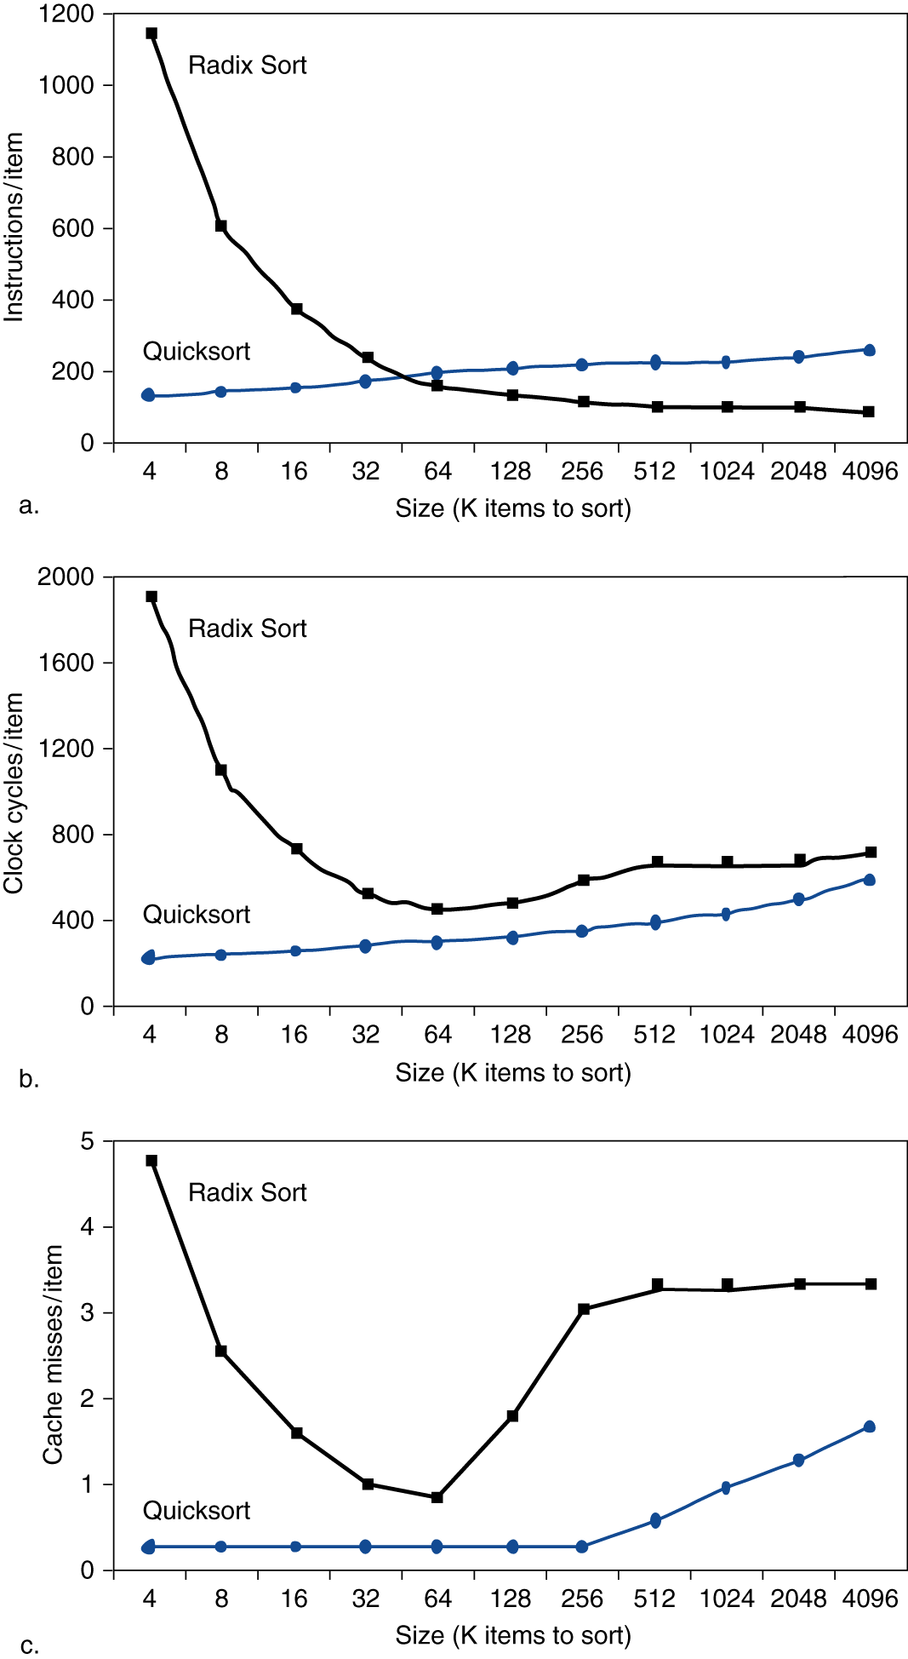
Interactions with Software
Misses depend on memory access patterns
Algorithm behavior
Compiler optimization for memory access

Slide 58
Virtual Memory
Use main memory as a “cache” for secondary (disk) storage
Managed jointly by CPU hardware and the operating system (OS)
Programs share main memory
Each gets a private virtual address space holding its frequently used code and data
Protected from other programs
CPU and OS translate virtual addresses to physical addresses
VM “block” is called a page
VM translation “miss” is called a page fault

Slide 59
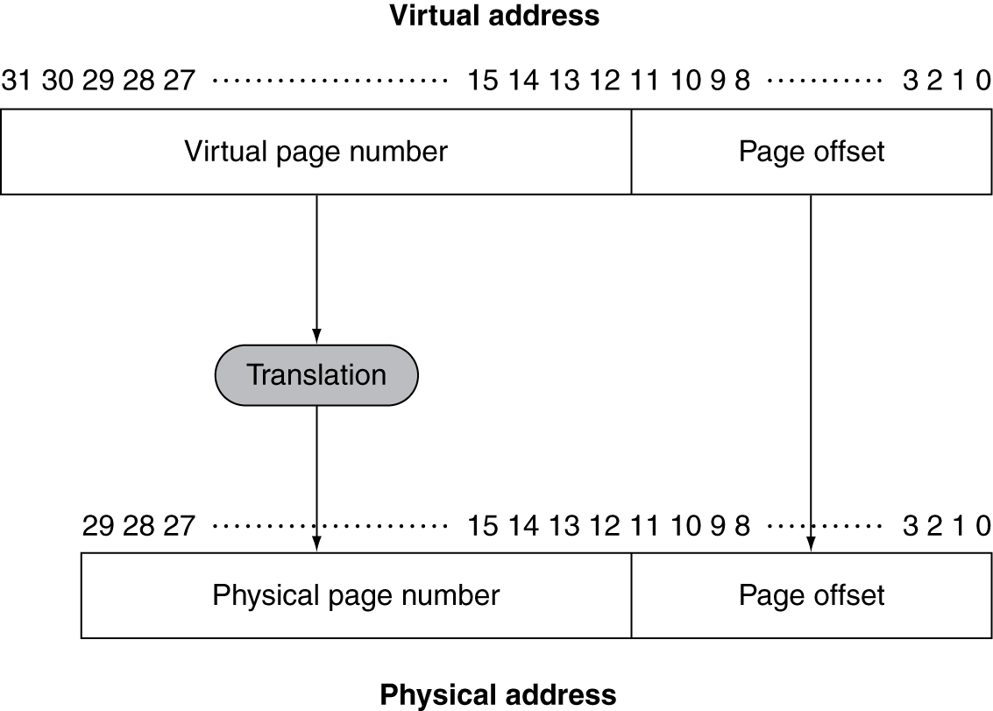
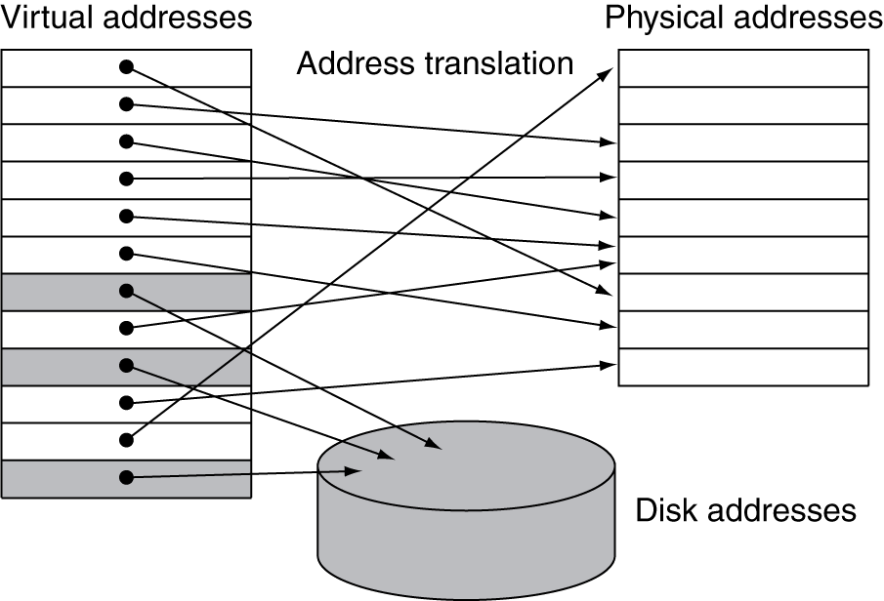
Address Translation
Fixed-size pages (e.g., 4K)
Virtual memory implements the translation of a program’s address space to physical addresses (address in main memory)

Slide 60
Page Fault Penalty
On page fault, the page must be fetched from disk
Takes millions of clock cycles
Handled by OS code
Try to minimize page fault rate
Fully associative placement
Smart replacement algorithms
Locate pages using a table that indexes the memory (page table)

Slide 61
Page Tables
Stores placement information
Each program has its own page table
Array of page table entries, indexed by virtual page number
Page table register in CPU points to page table in physical memory
If page is present in memory
PTE stores the physical page number
Plus other status bits (referenced, dirty, …)

Slide 62
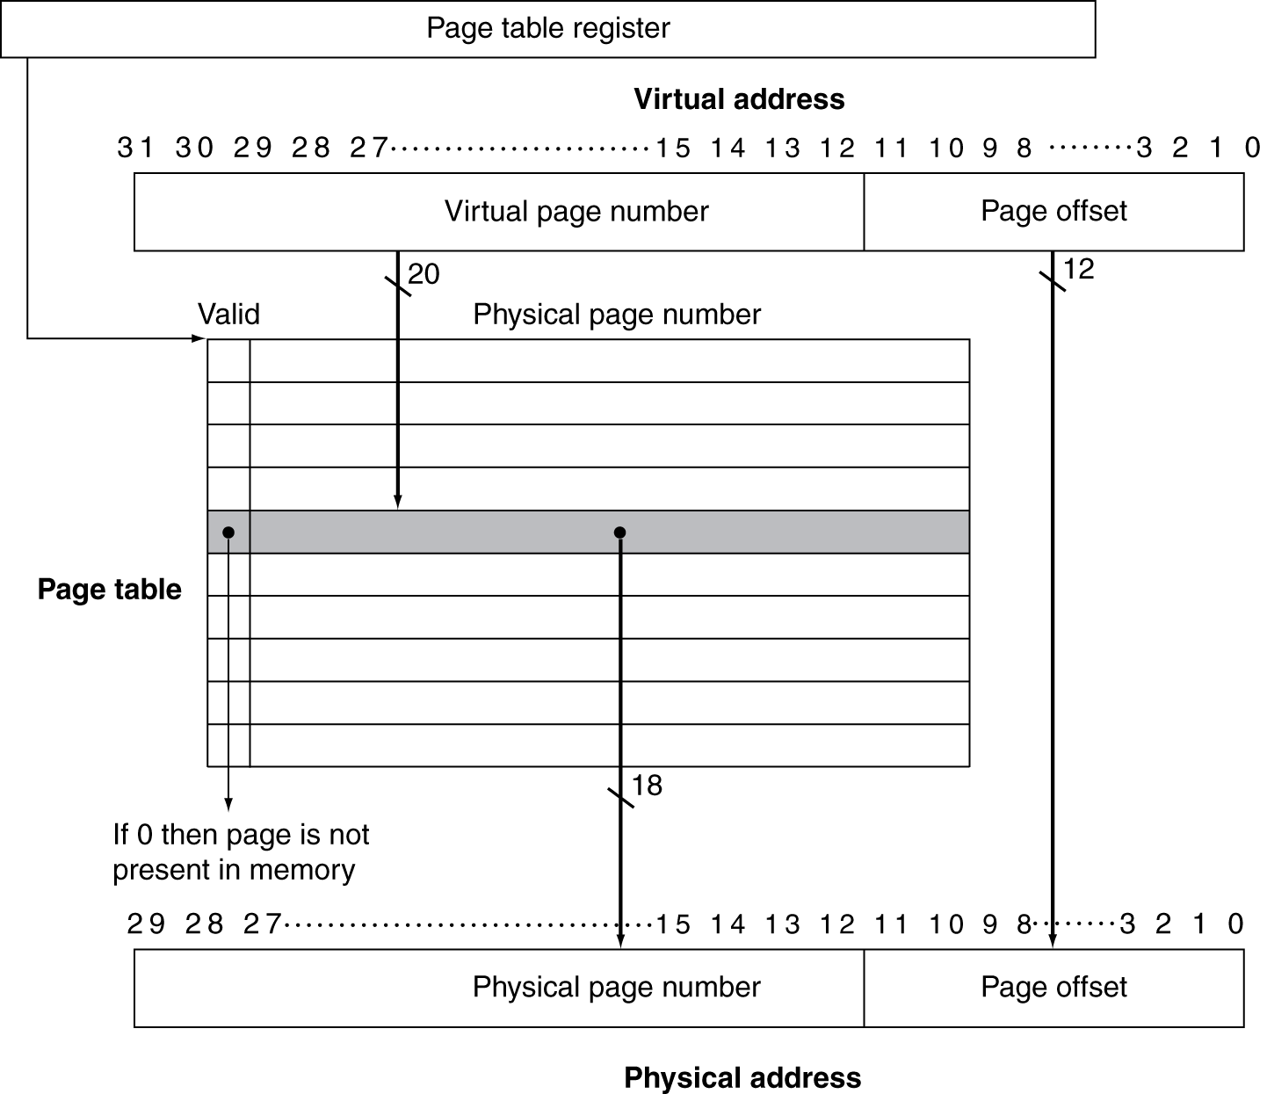
Translation Using a Page Table

Slide 63
Page Tables
If page is not present
OS gets control and find the page in the next level
PTE can refer to location in swap space on disk
Swap space
The space on the disk reserved for the full virtual memory space of a process
OS creates data structure to record where each virtual page is stored on disk
May be part of the page table or auxiliary data structure indexed the same way as page table.

Slide 64
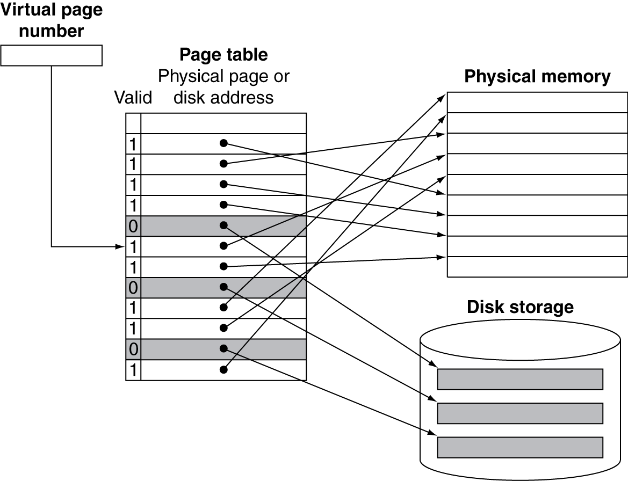
Mapping Pages to Storage

Slide 65
Replacement and Writes
To reduce page fault rate, prefer least-recently used (LRU) replacement
Reference bit (aka use bit) in PTE set to 1 on access to page
Periodically cleared to 0 by OS
A page with reference bit = 0 has not been used recently
Disk writes take millions of cycles
Block at once, not individual locations
Write through is impractical
Use write-back
Dirty bit in PTE set when page is written

Slide 66
Fast Translation Using a TLB
Address translation would appear to require extra memory references
One to access the PTE
Then the actual memory access
But access to page tables has good locality
So use a fast cache of PTEs within the CPU
Called a Translation Look-aside Buffer (TLB)
Typical: 16–512 PTEs, 0.5–1 cycle for hit, 10–100 cycles for miss, 0.01%–1% miss rate
Misses could be handled by hardware or software

Slide 67
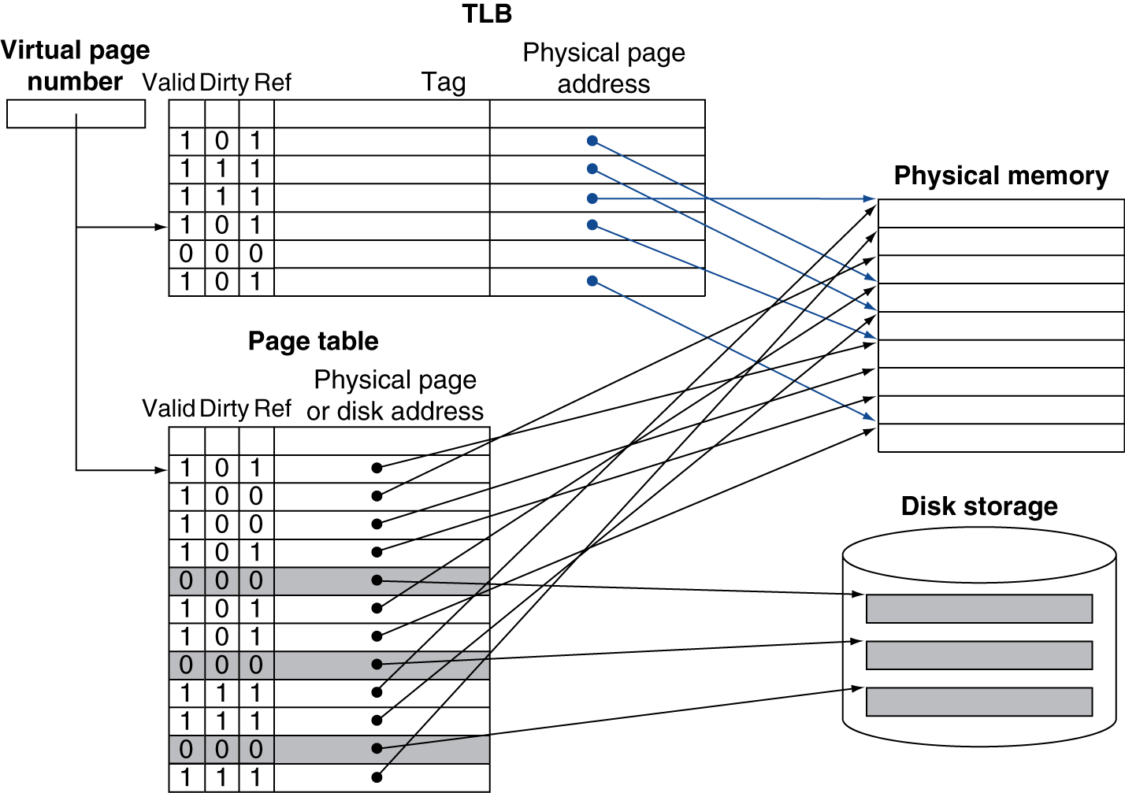
Fast Translation Using a TLB

Slide 68
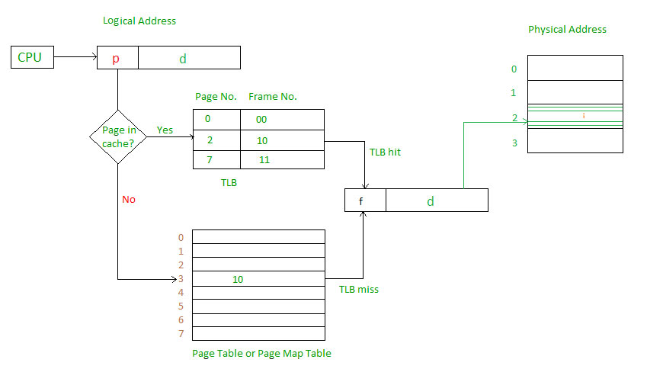
TLB

Slide 69
TLB Misses
If page is in memory
Load the PTE from memory and retry
Could be handled in hardware
Can get complex for more complicated page table structures
Or in software
Raise a special exception, with optimized handler
If page is not in memory (page fault)
OS handles fetching the page and updating the page table
Then restart the faulting instruction

Slide 70
TLB Miss Handler
TLB miss indicates
Page present, but PTE not in TLB
Page not preset
Must recognize TLB miss before destination register overwritten (exception asserted by the end of the same clock cycle that the memory access occur)
Raise exception with the next clock cycle.
Handler copies PTE from memory to TLB
Then restarts instruction
If page not present, page fault will occur

Slide 71
Page Fault Handler
Use faulting virtual address to find PTE
Locate page on disk
Choose page to replace
If dirty, write to disk first
Read page into memory and update page table
Make process runnable again
Restart from faulting instruction

Slide 72
The Memory Hierarchy
The BIG Picture
Common principles apply at all levels of the memory hierarchy
Based on notions of caching
At each level in the hierarchy
Block placement
Finding a block
Replacement on a miss
Write policy

Slide 73
Block Placement
Determined by associativity
Direct mapped (1-way associative)
One choice for placement
n-way set associative
n choices within a set
Fully associative
Any location
Higher associativity reduces miss rate
Increases complexity, cost, and access time

Slide 74
Finding a Block
Associativity | Location method | Tag comparisons
Direct mapped | Index | 1
n-way set associative | Set index, then search entries within the set | n
Fully associative | Search all entries | #entries
 | Full lookup table | 0
Hardware caches
Reduce comparisons to reduce cost
Virtual memory
Full table lookup makes full associativity feasible
Benefit in reduced miss rate

Slide 75
Replacement
Choice of entry to replace on a miss
Least recently used (LRU)
Complex and costly hardware for high associativity
Random
Close to LRU, easier to implement
Virtual memory
LRU approximation with hardware support

Slide 76
Write Policy
Write-through
Update both upper and lower levels
Simplifies replacement, but may require write buffer
Write-back
Update upper level only
Update lower level when block is replaced
Need to keep more state
Virtual memory
Only write-back is feasible, given disk write latency

Slide 77
Sources of Misses
Compulsory misses (aka cold start misses)
First access to a block
Capacity misses
Due to finite cache size
A replaced block is later accessed again
Conflict misses (aka collision misses)
In a non-fully associative cache
Due to competition for entries in a set
Would not occur in a fully associative cache of the same total size

Slide 78
Cache Design Trade-offs
Design change | Effect on miss rate | Negative performance effect
Increase cache size | Decrease capacity misses | May increase access time
Increase associativity | Decrease conflict misses | May increase access time
Increase block size | Decrease compulsory misses | Increases miss penalty. For very large block size, may increase miss rate due to pollution.

Slide 79
Concluding Remarks
Fast memories are small, large memories are slow
We really want fast, large memories ☹
Caching gives this illusion ☺
Principle of locality
Programs use a small part of their memory space frequently
Memory hierarchy
L1 cache ↔ L2 cache ↔ … ↔ DRAM memory ↔ disk
Memory system design is critical for multiprocessors

Slide 80
Problem 1
Consider a 2-way set associative mapped cache of size 16 KB with block size 256 bytes. The size of main memory is 128 KB. Find-
Number of bits in tag
Tag directory size
https://www.gatevidyalay.com/set-associative-mapping-practice-problems/

Slide 81
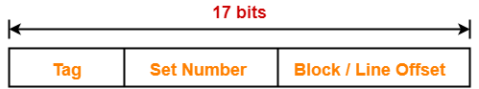
Solution 1
Given-
Set size = 2
Cache memory size = 16 KB
Block size = Frame size = Line size = 256 bytes
Main memory size = 128 KB = 2¹⁷ bytes
We consider that the memory is byte addressable.
Thus, Number of bits in physical address = 17 bits

Slide 82
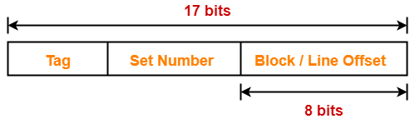
Solution 1
We have, Block size = 256 bytes = 2⁸ bytes
Thus, Number of bits in block offset = 8 bits
Total number of lines in cache = Cache size / Line size
= 16 KB / 256 bytes = 2¹⁴ bytes / 2⁸ bytes = 64 lines
Thus, Number of lines in cache = 64 lines

Slide 83
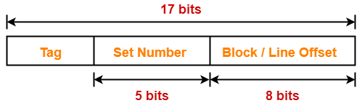
Solution 1
Total number of sets in cache
= Total number of lines in cache / Set size
= 64 / 2 = 32 sets = 2⁵ sets
Thus, Number of bits in set number = 5 bits

Slide 84
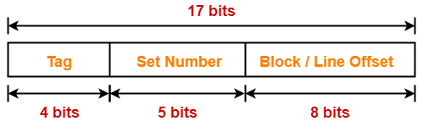
Solution 1
Number of bits in tag
= Number of bits in physical address – (Number of bits in set number + Number of bits in block offset)
= 17 bits – (5 bits + 8 bits) = 17 bits – 13 bits = 4 bits
Thus, Number of bits in tag = 4 bits

Slide 85
Solution 1
Tag directory size = Number of tags x Tag size
= Number of lines in cache x Number of bits in tag
= 64 x 4 bits = 256 bits = 32 bytes
Thus, size of tag directory = 32 bytes

Slide 86
Problem 2
Consider a 8-way set associative mapped cache of size 512 KB with block size 1 KB. There are 7 bits in the tag. Find-
Size of main memory
Tag directory size
https://www.gatevidyalay.com/set-associative-mapping-practice-problems/

Slide 87
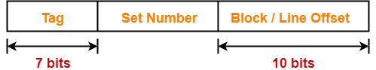
Solution 2
Given-
Set size = 8
Cache memory size = 512 KB
Block size = Frame size = Line size = 1 KB = 2¹⁰ bytes
Number of bits in tag = 7 bits
We consider that the memory is byte addressable.
Number of bits in block offset = 10 bits (Block size = 2¹⁰ bytes)

Slide 88
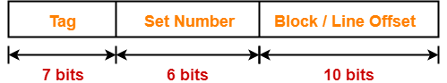
Solution 2
Total number of lines in cache
= Cache size / Line size = 512 KB / 1 KB = 512 lines
Thus, Number of lines in cache = 512 lines
Total number of sets in cache
= Total number of lines in cache / Set size
= 512 / 8 = 64 sets = 2⁶ sets
Thus, Number of bits in set number = 6 bits

Slide 89
Solution 2
Number of bits in physical address
= Number of bits in tag + Number of bits in set number + Number of bits in block offset
= 7 bits + 6 bits + 10 bits = 23 bits
Thus, Number of bits in physical address = 23 bits

Slide 90
Solution 2
We have, Number of bits in physical address = 23 bits
Thus, Size of main memory = 2²³ bytes = 8 MB
Tag directory size
= Number of tags x Tag size
= Number of lines in cache x Number of bits in tag
= 512 x 7 bits = 3584 bits = 448 bytes
Thus, size of tag directory = 448 bytes

Slide 91
More problems
https://www.gatevidyalay.com/set-associative-mapping-practice-problems/
https://www.gatevidyalay.com/direct-mapping-cache-practice-problems/
http://web.cecs.pdx.edu/~zeshan/cache_solved_examples.pdf
http://www.cs.ucf.edu/~skhan/Teaching/CDA3103_Summer2014/slides/Lecture14/Numericals_cache.pdf
https://www3.nd.edu/~mniemier/teaching/2010_B_Fall/lectures/lec_20_board.pdf

